Slide 1
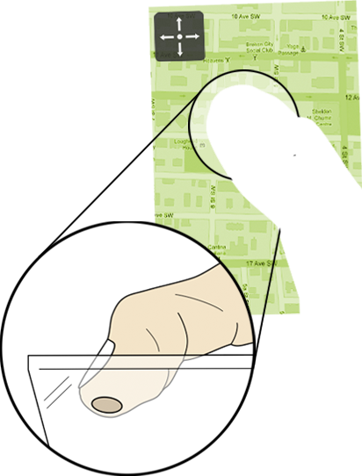
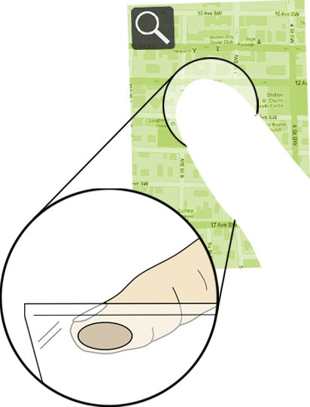

The Fat Thumb
Using the Thumb’s Contact Size For Single-Handed Mobile Interaction
Sebastian Boring, David Ledo, Xiang ‘Anthony’ Chen,
Nicolai Marquardt, Anthony Tang, Saul Greenberg
Interactions Lab, University of Calgary, Canada

Slide 2


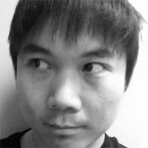


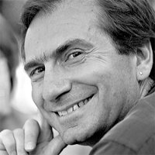
authors
Sebastian Boring
University of Calgary
David Ledo
University of Calgary
Xiang ‘Anthony’ Chen
University of Calgary (now: Carnegie Mellon University)
Nicolai Marquardt
University of Calgary
Anthony Tang
University of Calgary
Saul Greenberg
University of Calgary

Slide 3
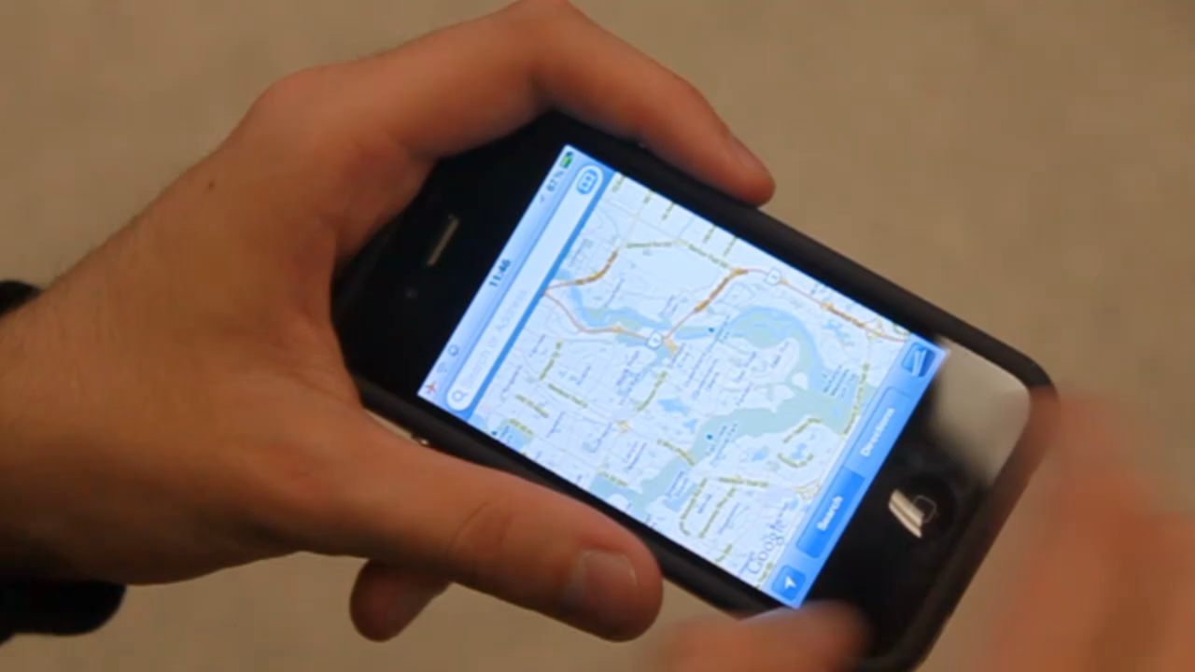

Slide 4
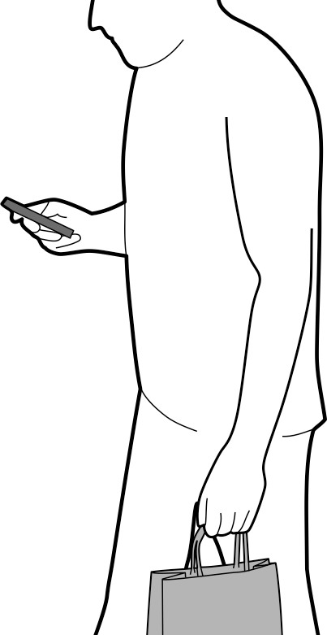
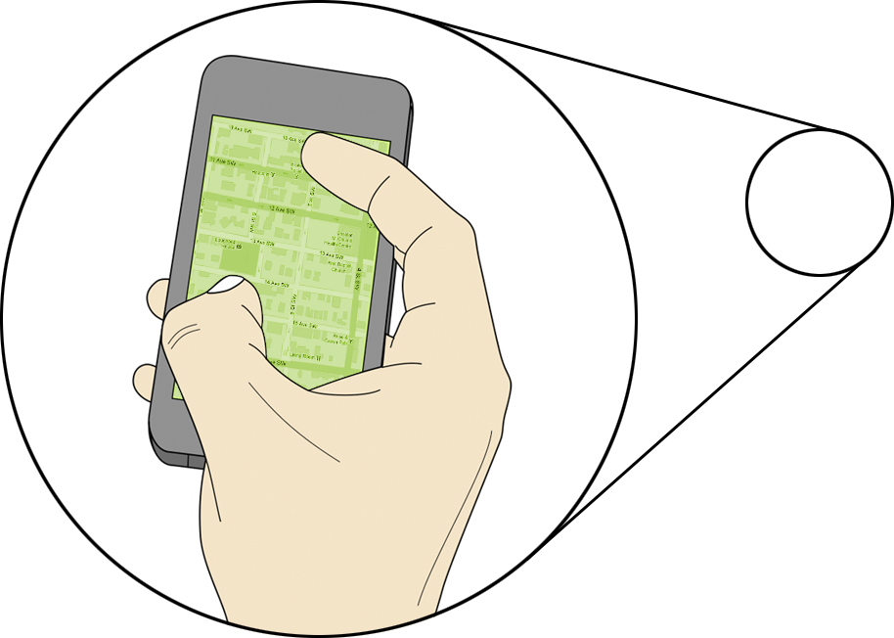
one-handed interaction
how to switch between modes?

Slide 5
contact size as mode switch
while the touch is in motion

Slide 6
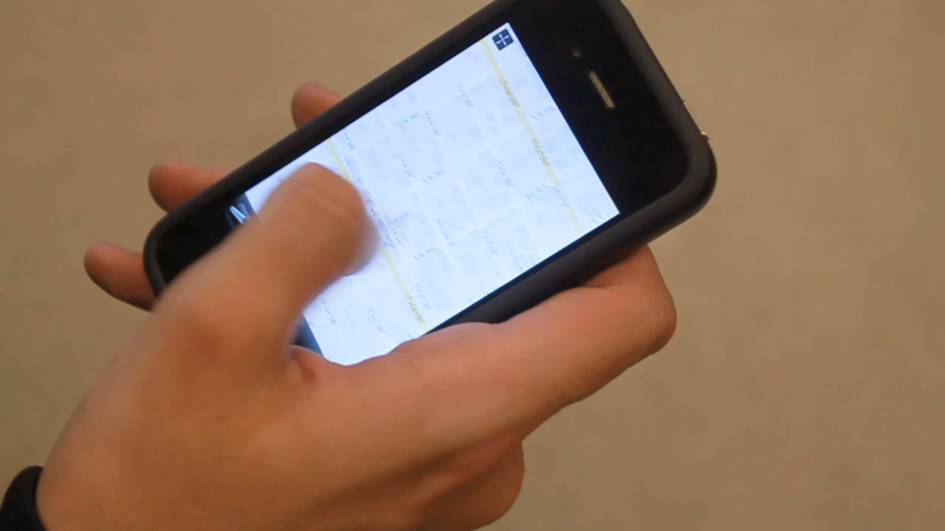

Slide 7
background
thumb-based mobile touch input

Slide 8
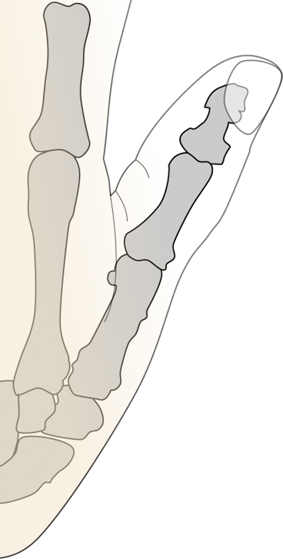
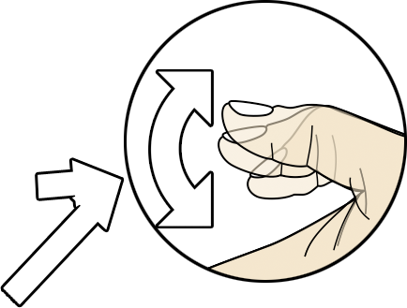
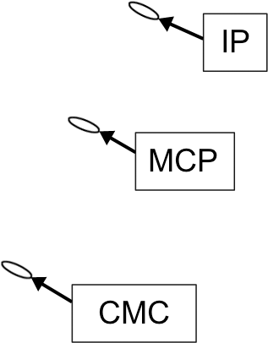
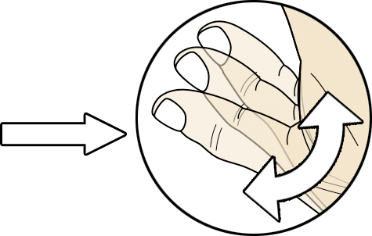

Slide 9
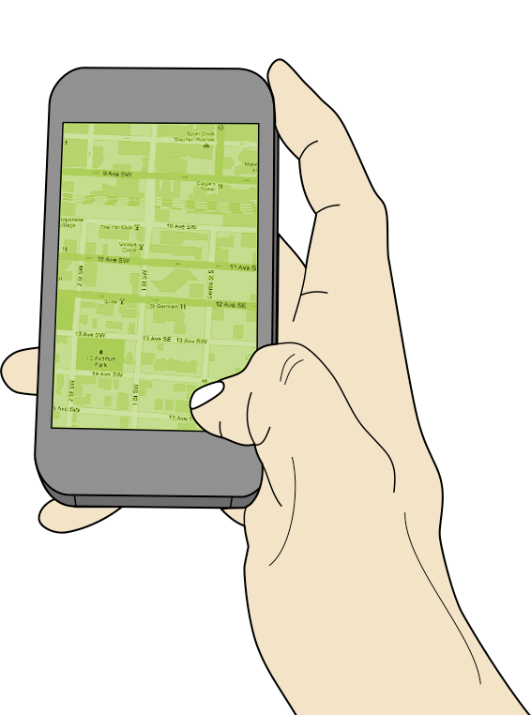
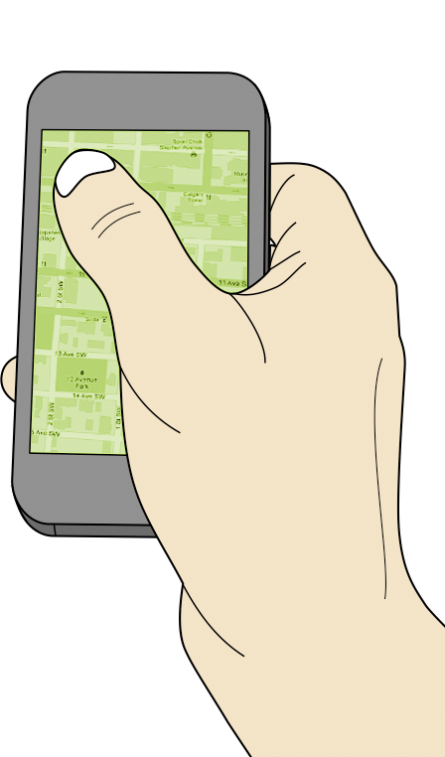
corners are hard to reach

Slide 10
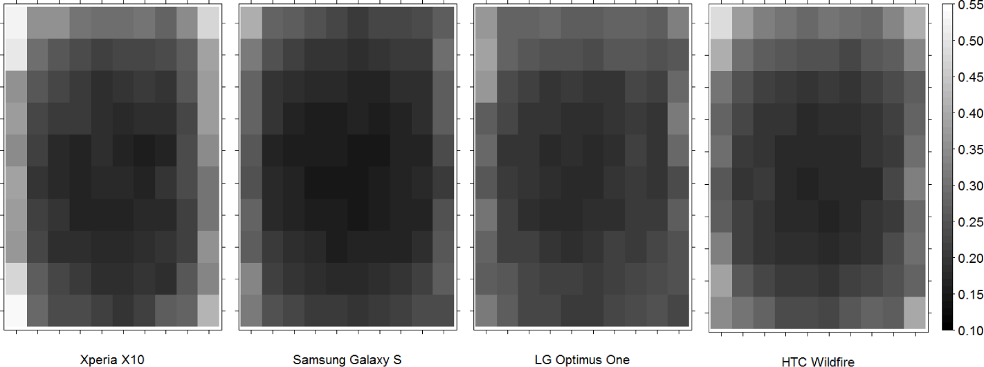
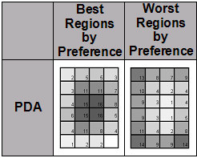
100,000,000 Taps [Henze et al., MobileHCI 2011]
center is the sweet spot
Mobile Phone Studies
[Karlson et al., TR Maryland 2006]

Slide 11
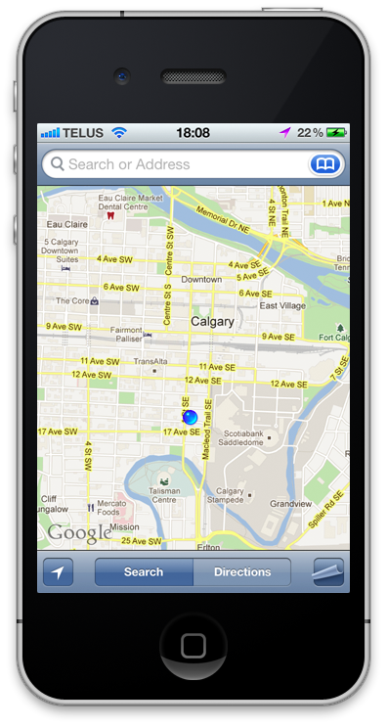
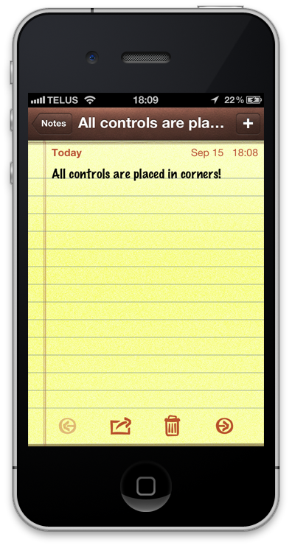
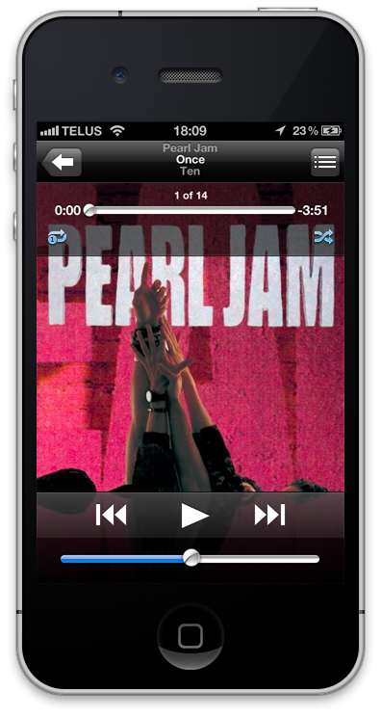
controls are located on borders

Slide 12
or directly in corners

Slide 13
related work
performance, expressivity, pressure & shape

Slide 14
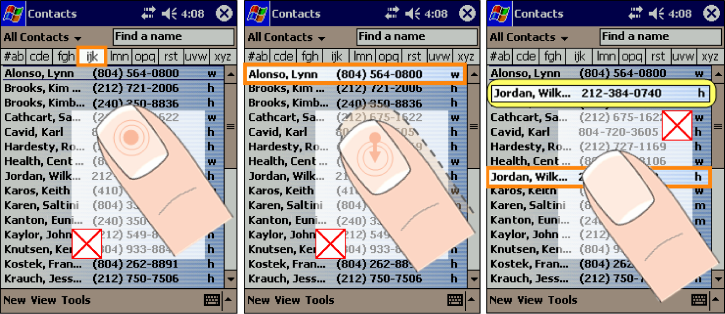
1
the thumb’s reachability
ThumbSpace [Karlson et al., Interact 2007]

Slide 15
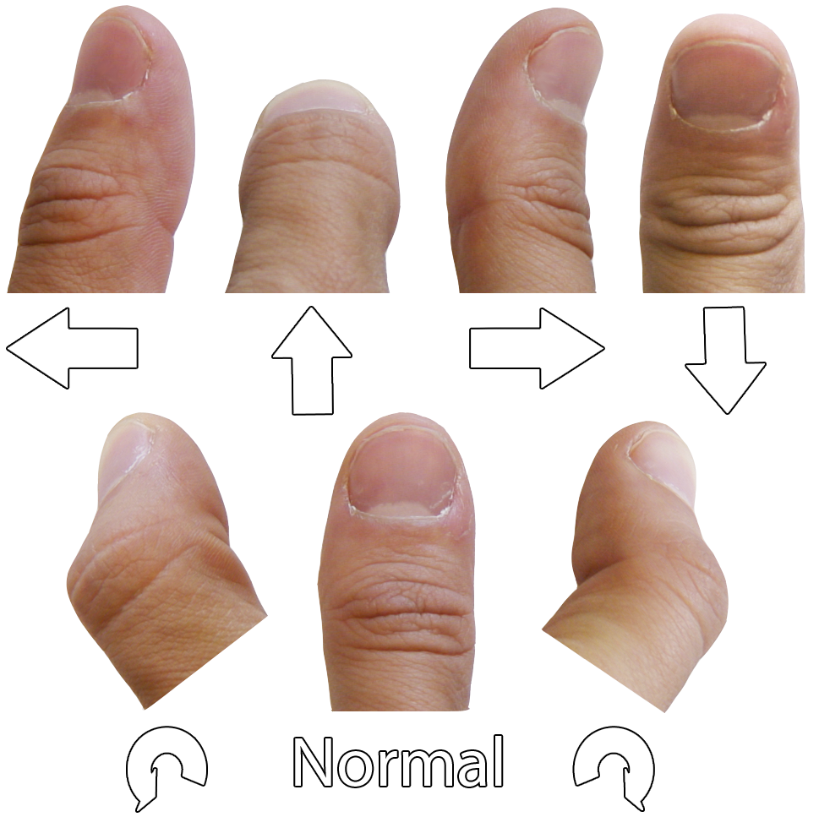
2
expressivity of touch
MicroRolls [Roudaut et al., CHI 2009]

Slide 16
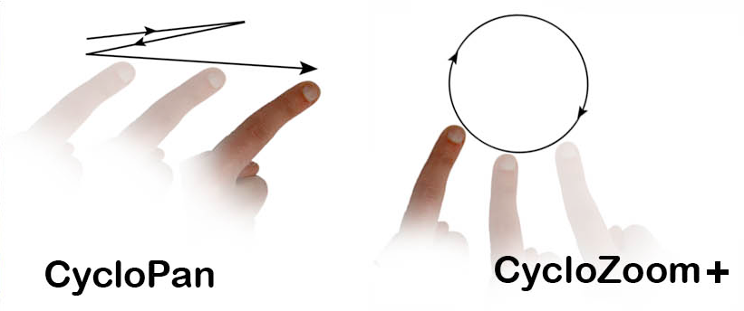
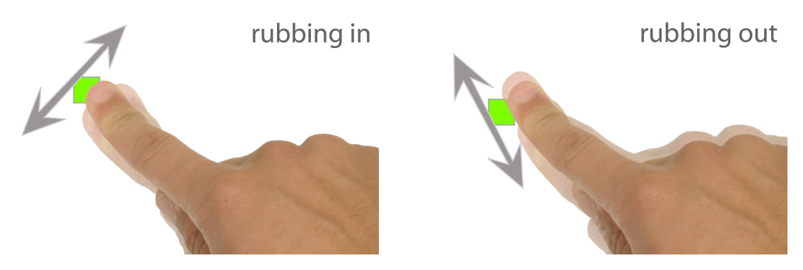
2
expressivity of touch
CycloPan & CycloStar [Malacria et al., CHI 2010]
Rubbing & Tapping [Olwal et al., CHI 2008]

Slide 17
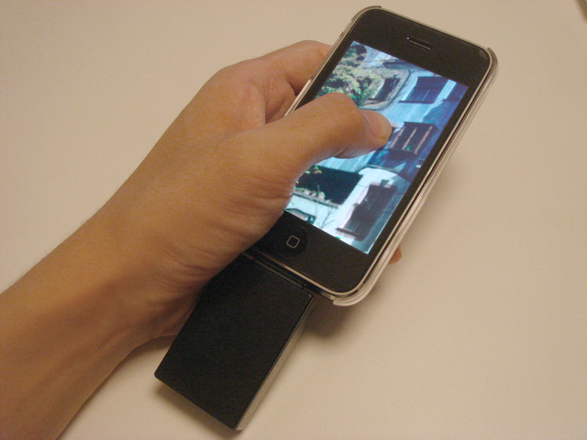
3
pressure & shape
GraspZoom [Miyaki et al., MobileHCI 2009]

Slide 18
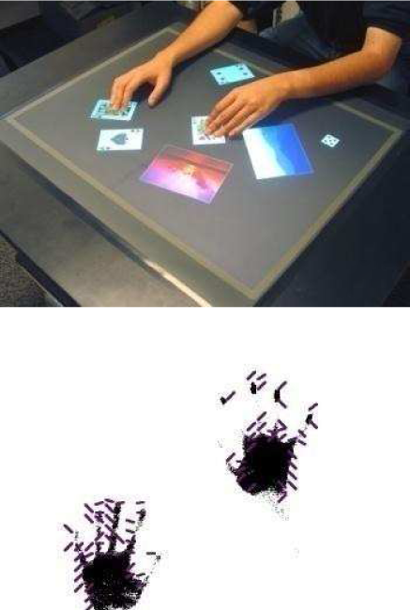
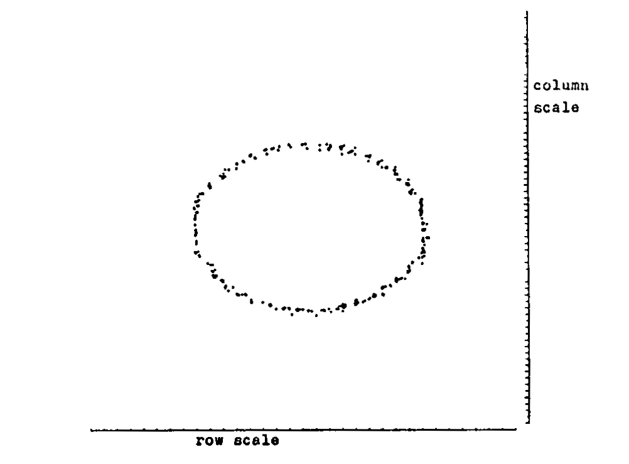
3
pressure & shape
Shape Detection [Lee et al., CHI 1985]
ShapeTouch [Cao et al., Tabletop 2008]

Slide 19
the thumb’s motion
applying different input modes

Slide 20
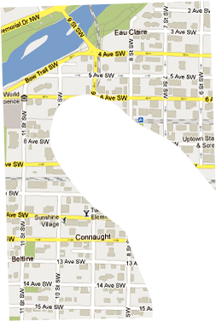
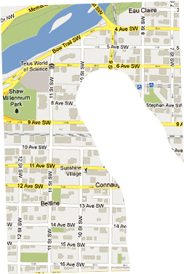
1
moving the thumb
panning the map
pan

Slide 21
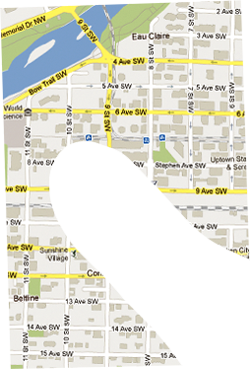
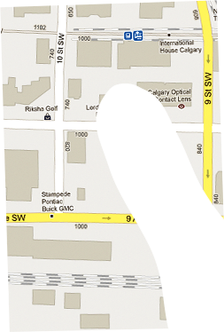
2
moving the thumb
zooming the map
zoom

Slide 22
ambiguity of motion
how to switch between operations?
?

Slide 23
pressure vs. pitch
changing the meaning of touch motion

Slide 24
1
pressure-based input
normal touch
press
w
≈w
w
≈w

Slide 25
2
changing the pitch
normal touch
pitch
w
≫ w
w
≫ w

Slide 26
pressure induces friction
when the thumb is in motion
press
pitch

Slide 27
implementation
making use of the contact size

Slide 28
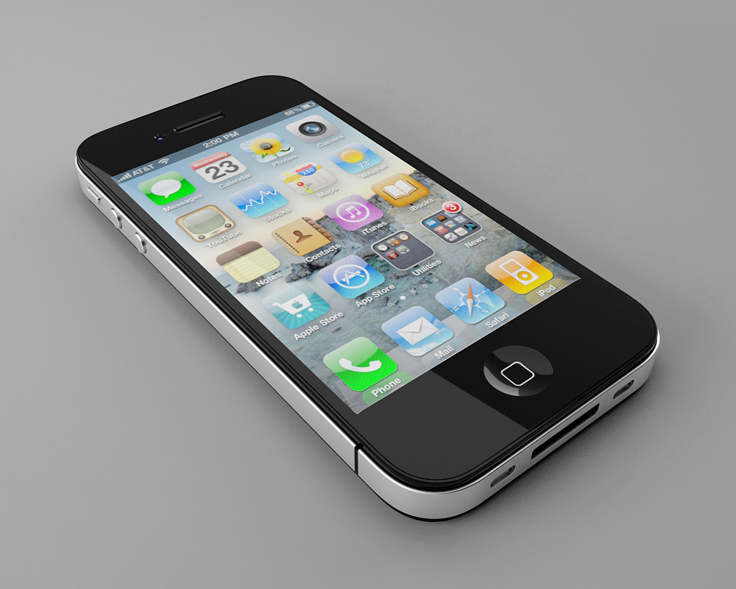
1
getting the contact size
on today’s hardware
NSValue *value = [touch valueForKey:@”_pathMajorRadius”];
float size = [value floatValue]; // size in pixels

Slide 29
2
estimate the orientation
and correcting for input

Slide 30
2
estimate the orientation
and correcting for input
Sensed
Location
Corrected
Location
Rotation
Center

Slide 31
3
calibration
people have different contact sizes
alternate
Min. Size
Max. Size
0.0
1.0

Slide 32
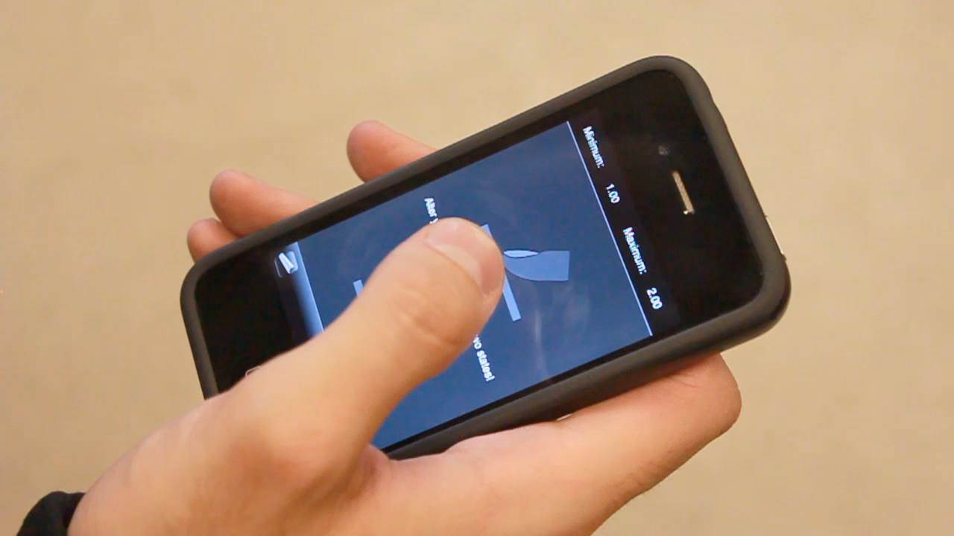

Slide 33
example application
using pan or zoom based on contact size

Slide 34
1
pan or zoom?
switch based on the contact size
Pan
Zoom
Min. Size
Max. Size
0.0
1.0

Slide 35
2
panning
use x,y position directly
Δv

Slide 36
2
zooming
use angular change
Δα

Slide 37
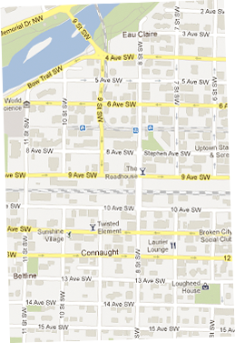
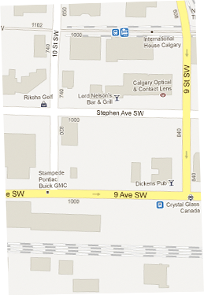
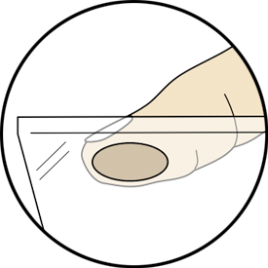
3
adjusting zoom factor
less contact size means smaller change

Slide 38
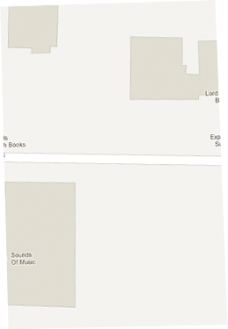

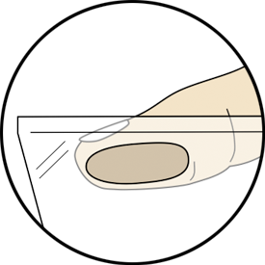
3
adjust zoom factor
more contact size means higher change

Slide 39
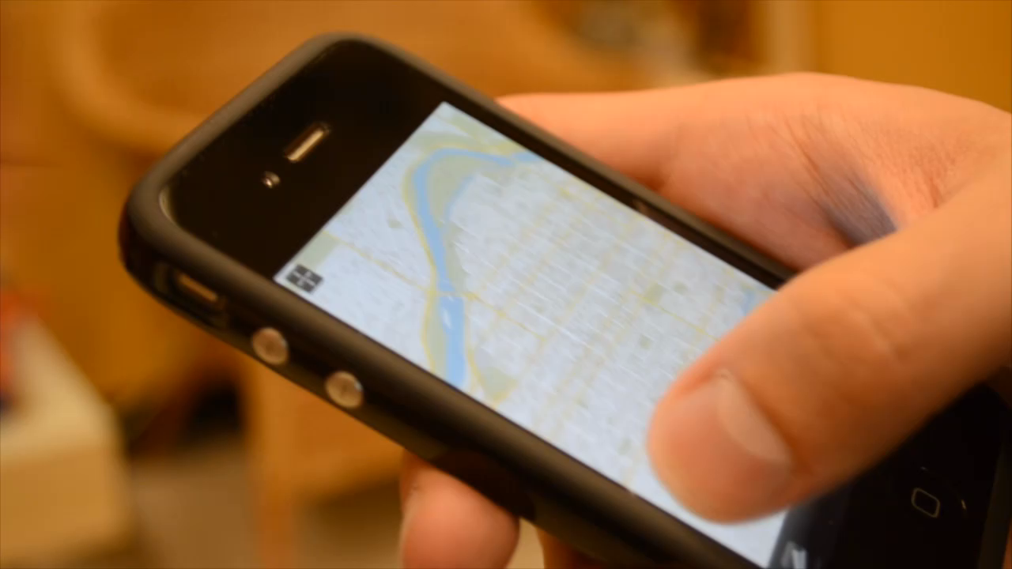

Slide 40
user study
aligning rectangles with the display

Slide 41
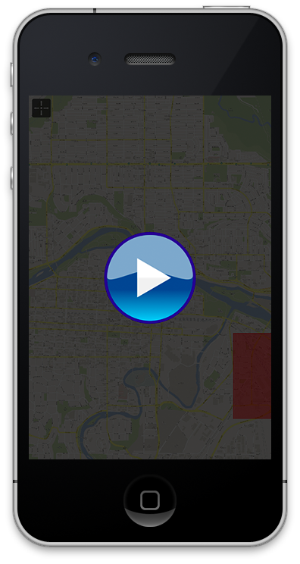
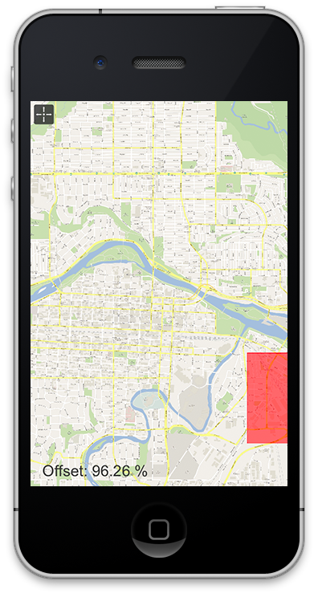
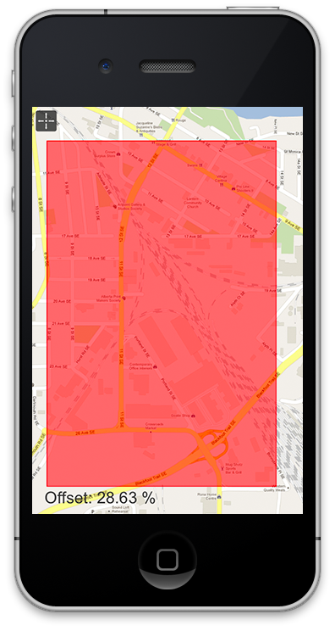
1
task

Slide 42
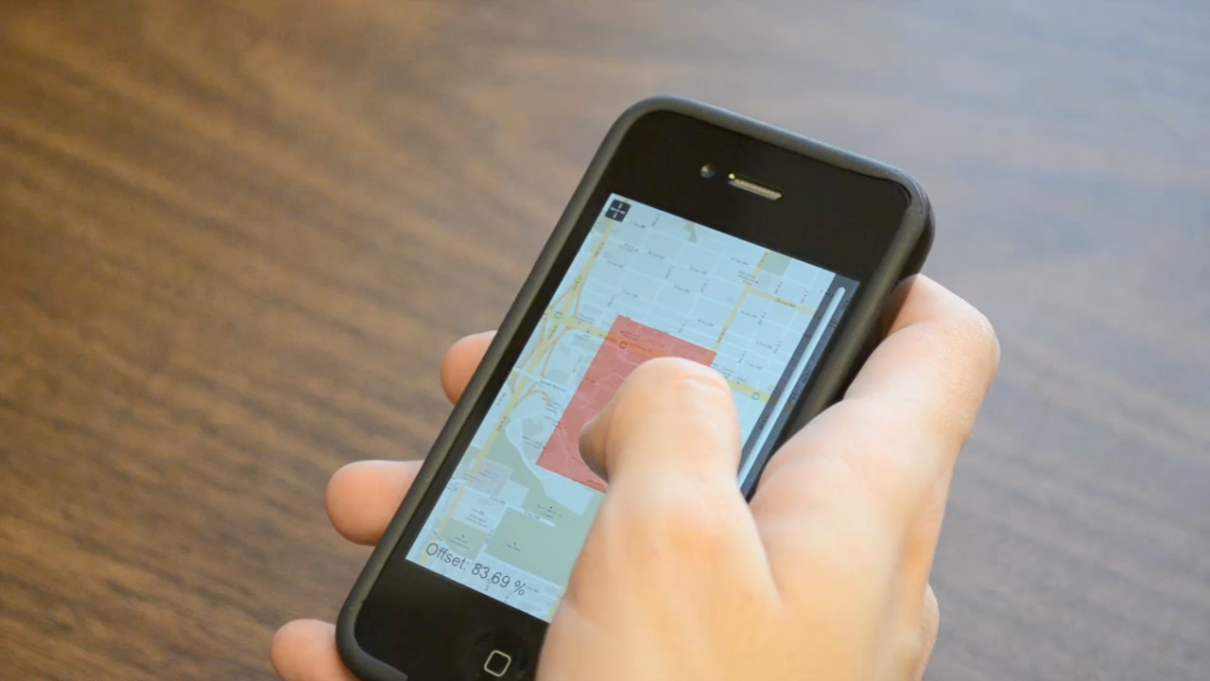
2
interfaces: slider

Slide 43
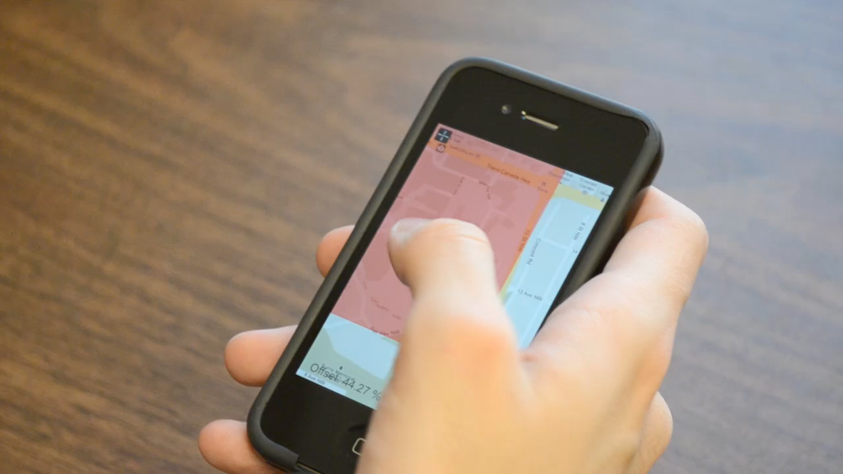
2
interfaces: cyclostar
CycloPan & CycloStar [Malacria et al., CHI 2010]

Slide 44
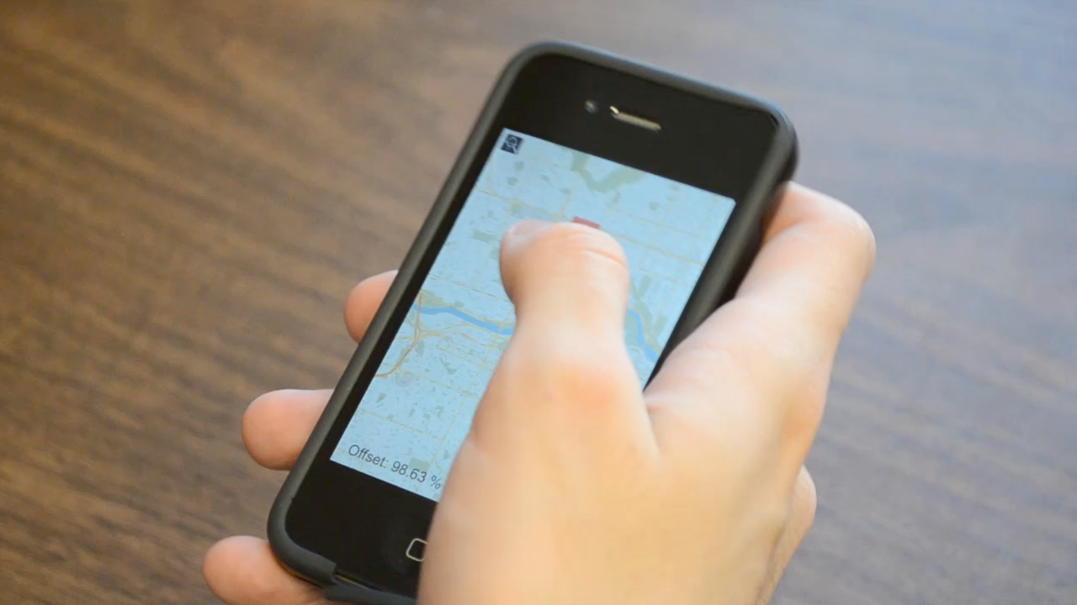
2
interfaces: tilt-to-zoom
Tilt-to-Zoom (Sensor Synaesthesia) [Hinckley et al., CHI 2011]

Slide 45
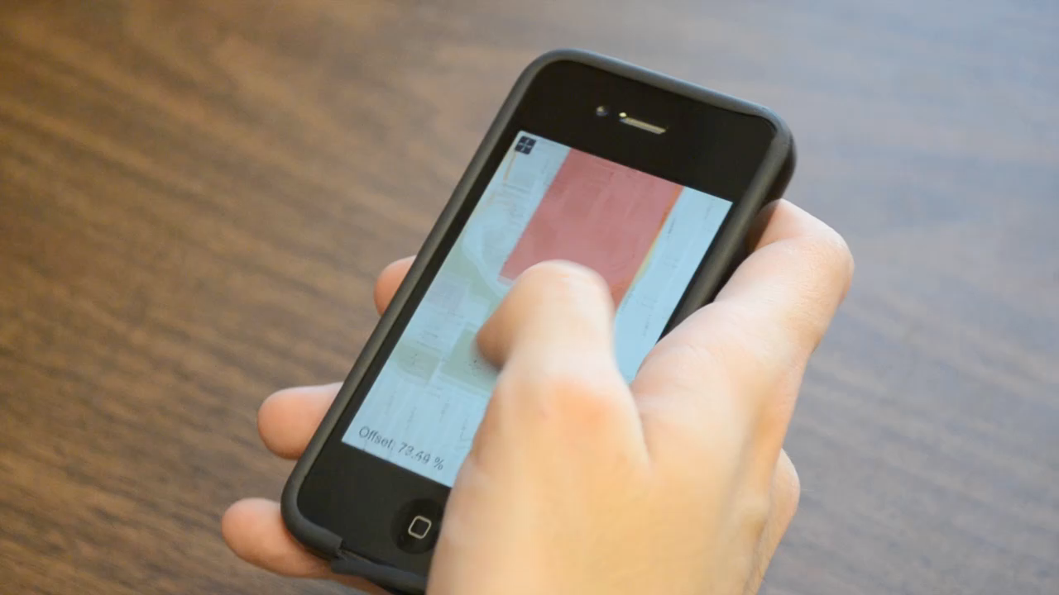
2
interfaces: fat thumb

Slide 46
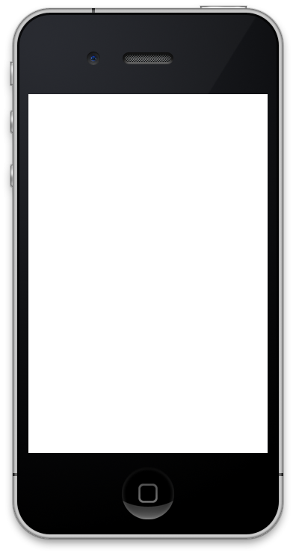
3
target sizes
width = 1.8 cm
height = 2.7 cm
width = 1.2 cm
height = 1.8 cm
width = 0.6 cm
height = 0.9 cm

Slide 47
4
target locations
2 cm
2.25 cm
2.25 cm
2 cm

Slide 48
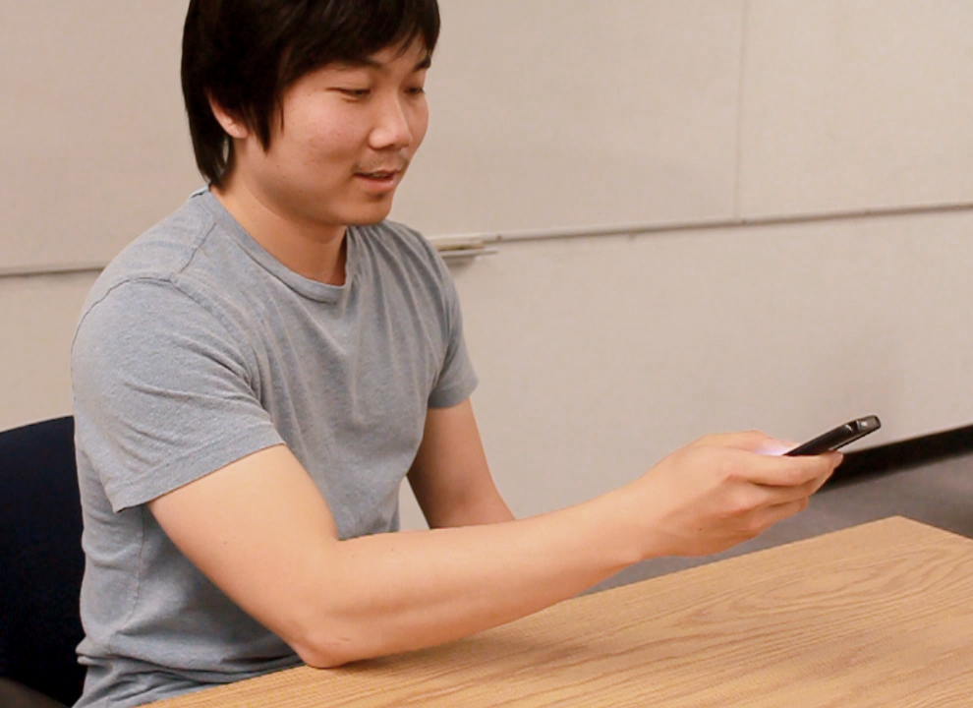
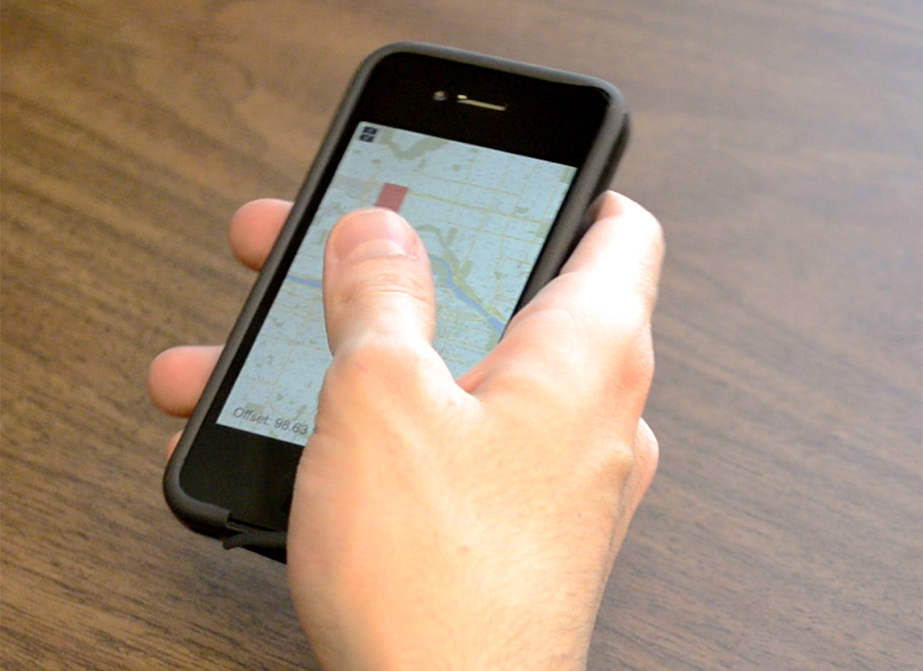
experimental design
[4 Interfaces × 3 Target Sizes × 4 Target Locations]
3 repetitions for each cell (excluding training)
16 participants (10 female)

Slide 49
hypotheses
1
Fat Thumb more accurate for small targets
2
Fat Thumb faster for small targets
3
Fat Thumb & Tilt-to-Zoom require less strokes
4
Fat Thumb is most preferred technique

Slide 50
results
offset, strokes, task time

Slide 51
offset
40%
CycloStar
Slider
Tilt-to-Zoom
Fat Thumb
30%
20%
10%
0%
Small
Medium
Large

Slide 52
offset
40%
CycloStar
Slider
Tilt-to-Zoom
Fat Thumb
30%
20%
10%
0%
Small
Medium
Large

Slide 53
number of strokes
25
CycloStar
Slider
Tilt-to-Zoom
Fat Thumb
20
15
10
5
0
Small
Medium
Large

Slide 54
number of strokes
25
CycloStar
Slider
Tilt-to-Zoom
Fat Thumb
20
15
10
5
0
Small
Medium
Large

Slide 55
number of strokes
25
CycloStar
Slider
Tilt-to-Zoom
Fat Thumb
20
15
10
5
0
Small
Medium
Large

Slide 56
task time
25s
CycloStar
Slider
Tilt-to-Zoom
Fat Thumb
20s
15s
10s
5s
task times extremely high
0s
Small
Medium
Large

Slide 57
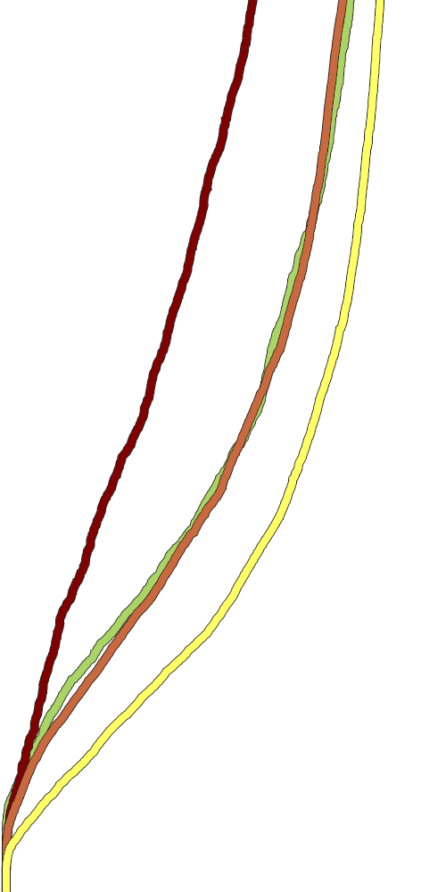
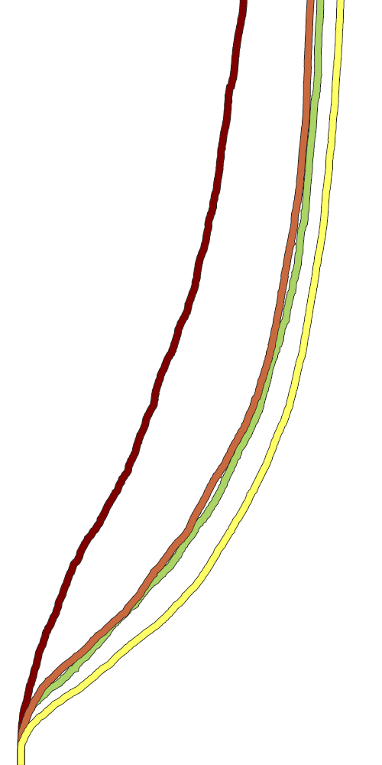

offset over time
CycloStar
Slider
Tilt-to-Zoom
Fat Thumb
5s
5s
5s
4s
4s
4s
3s
3s
3s
2s
2s
2s
1s
1s
1s
100%
80%
60%
40%
20%
100%
80%
60%
40%
20%
100%
80%
60%
40%
20%
Small
Medium
Large

Slide 58
subjective preferences
5
CycloStar
Slider
12
Tilt-to-Zoom
Fat Thumb
11
4.5
4
9
4
4
4
3
6
3
3
3
3
2
3
4
2
2
2
1.5
1
0
0
1
Finger
Fatigue
Wrist
Fatigue
General
Comfort
Preferred
Technique

Slide 59
subjective preferences
5
CycloStar
Slider
12
Tilt-to-Zoom
Fat Thumb
11
4.5
4
9
4
4
4
3
6
3
3
3
3
2
3
4
2
2
2
1.5
1
0
0
1
Finger
Fatigue
Wrist
Fatigue
General
Comfort
Preferred
Technique

Slide 60
subjective preferences
5
CycloStar
Slider
12
Tilt-to-Zoom
Fat Thumb
11
4.5
4
9
4
4
4
3
6
3
3
3
3
2
3
4
2
2
2
1.5
1
0
0
1
Finger
Fatigue
Wrist
Fatigue
General
Comfort
Preferred
Technique

Slide 61


heatmaps
where did people touch?
Slider
CycloStar
circular
motions
hard to
reach

Slide 62


heatmaps
where did people touch?
Tilt-to-Zoom
Fat Thumb
easy to
reach

Slide 63
results
1
Fat Thumb more accurate for small targets
2
Fat Thumb faster for small targets
3
Fat Thumb & Tilt-to-Zoom require less strokes
4
Fat Thumb is most preferred technique

Slide 64
next?
other applications & devices

Slide 65



1
applications
contact-size dependent speed
Tilt-to-Zoom
Fat Thumb

Slide 66
1
applications
contact-size dependent speed
Tilt-to-Zoom
Fat Thumb

Slide 67

2
tablet PCs?
the fat index finger
Tilt-to-Zoom
Fat Thumb

Slide 68
Q?
Sebastian Boring, David Ledo, Xiang ‘Anthony’ Chen,
Nicolai Marquardt, Anthony Tang, Saul Greenberg
University of Calgary, Calgary, Alberta, Canada
Email: sebastian.boring@gmail.com
URL: http://www.sebastianboring.com

